Slide 1




CREDIT RISK PREDICTION
Nova Zidane Ibrahim
DATA SCIENTIST
PROJECT BASED INTERSHIP PROGRAM
2023

Slide 2
Table
of Content
01
PROBLEM
RESEARCH
04
DATA
MODELING
02
DATA
PROCESSING
05
BUSINESS
RECOMMENDATION
03
DATA
INSIGHTS
P
01

Slide 3


01
Problem
Research

Slide 4
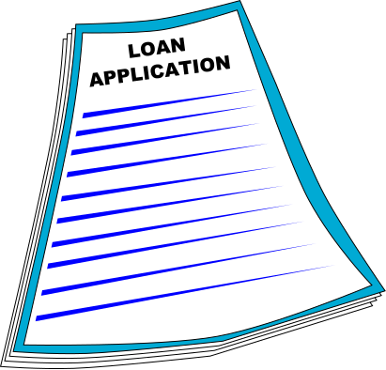
Business
Understanding
In this case, the lending company has to make a decision whether to approve or reject the loan application based on the applicant's profile.
Good Risk refers to a situation where the loan applicant has a high probability of repaying their loan.
Bad Risk refers to a situation where the loan applicant has a low probability of repaying their loan.
02

Slide 5

Problem Statement
Lending to applicants with Bad Risk is the biggest cause of financial loss. Credit losses are the amount of money lost by lenders when applicants refuse to pay or run away with money they should have paid.
Objectives
01.
Identify Patterns Indicating Bad Risk
Implementation of Machine Learning Algorithms to Build Predictive Models
02.
03

Slide 6

02
Data
Processing

Slide 7


Loan Data
75 Features
466,285 Rows
Modeling and Evaluation
Data Understanding
Check Missing Values, Unique Values, Data Type, and Statistical Summary for Each Features
Learning Algorithms:
Decision Tree Classifier
Random Forest Classifier
Logistic Regression
Gaussian Naive Bayes
XGBoost Classifier
Row Data
Data Preparation
Evaluation Methods:
Confusion Matrix
Accuracy
EDA
Data Cleansing
Data Preprocessing
Handling Imbalanced Data
using Oversampling
Encoding
using Manual Encoding, One-Hot-Encoding, dan Label Encoding
Feature Selection
using Pearson Correlation and visualize with Heatmap
Splitting
using Ratio 80:20
04

Slide 8

03
Data
Insight

Slide 9
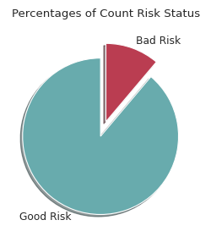
Target
Variable
From loan_status, we can cluster the unique values into 2 risk statuses:
Good Risk : Fully Paid, Current, and In Grace Period.
Bad Risk : Late, Default, and Charged Off,
The dataset has significant data imbalance:
Good Risk : 414,099 (88.81%)
Bad Risk : 52,186 (11.19%)
05

Slide 10
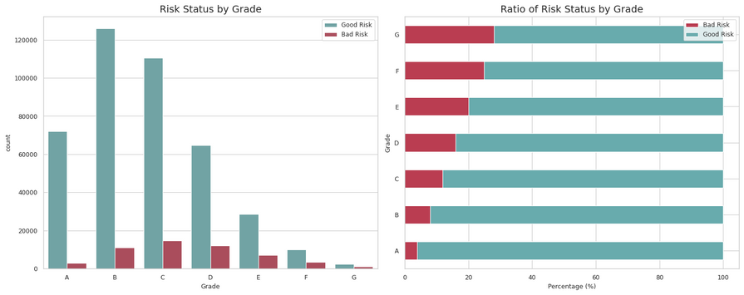
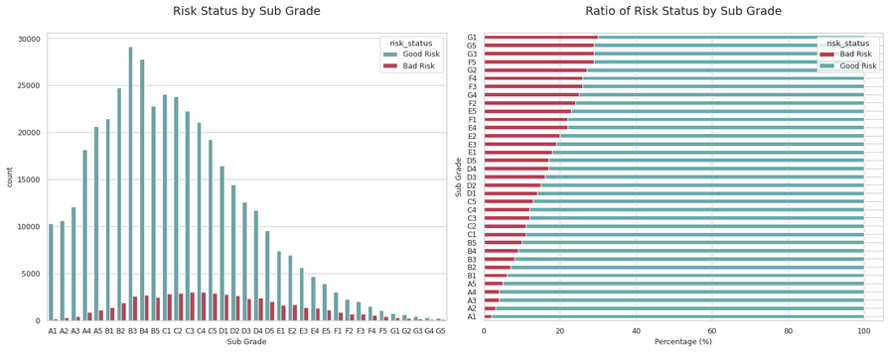
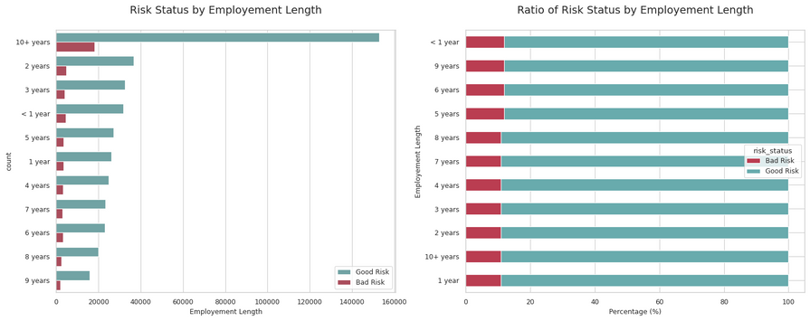
Categorical Variables
Applications with a Low Grade are more likely not to repay the loan.
Applications with a Low Sub Grade are more likely not to repay the loan.
Employement Length does not influence the Applications for risk.
06

Slide 11
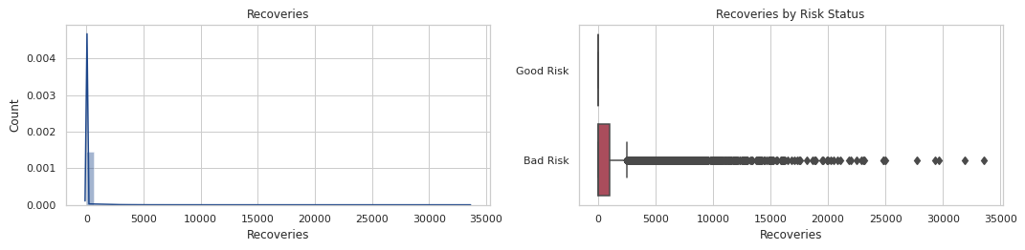
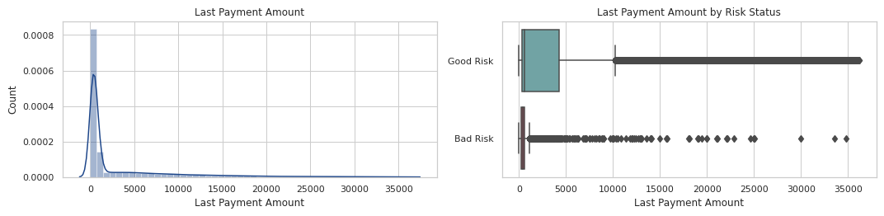
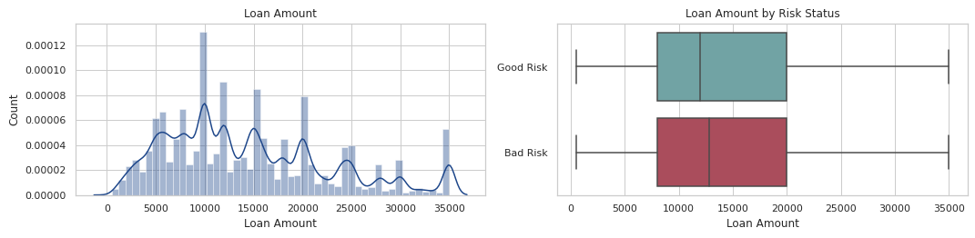
Numerical Variables
Applications without Recoveries are most likely to pay off the loan.
Applications with a Low Last Payment Amount are more likely not to repay the loan.
Loan Amount does not really affect the Applications for risk.
07

Slide 12
04
Modeling and
Evaluation

Slide 13

Model Comparison
Algorithms | Training Accuracy | Testing Accuracy | Error Margin
Decision Tree | 99.98% | 98.82% | 1.16%
Random Forest | 99.98% | 99.35% | 0.63%
Logistic Regression | 87.92% | 88.00% | 0.08%
Gaussian Naive Bayes | 75.19% | 75.22% | 0.03%
XGBoost Classifier | 95.90% | 95.94% | 0.04%
The best model to predict the risk status of loan applications is Random Forest.
Although Decision Tree and XGBoost also have very high accuracy, they have quite a small difference value from Random Forest. It is seen from the training and testing results that the Random Forest model is better than both in general.
08

Slide 14
recoveries
collection_recovery_fee
total_rec_prncp
Features
This model only uses 15 features that correlate to risk_status.
last_pymnt_d_year
total_pymnt_inv
total_pymnt
int_rate
Performance
The Random Forest model has a testing accuracy of 99.35%.
sub_grade
last_pymnt_amnt
grade
total_rec_late_fee
The Random Forest model has an error margin of 0.63%.
out_prncp
out_prncp_inv
last_credit_pull_d_year
last_pymnt_d_month
0
0,1
0,2
0,3
0,4
0,5
09

Slide 15
05
Business
Recommendation

Slide 16
Conclusion
The five most correlated features in determining the likelihood of loan repayment include `recoveries`, `collection_recovery_fee`, `total_resc_prncp`, `last_pymnt_d_year`, and `total_pymnt_inv`. These features are the most correlated in assessing loan repayment risk.
The recommended strategy for dealing with applicants who exhibit high-risk indicators is that if an applicant has characteristics associated with a high risk of not repaying the loan, the company should consider actions such as rejecting their loan application, reducing the loan amount, or charging a higher interest rate.
10

Slide 17
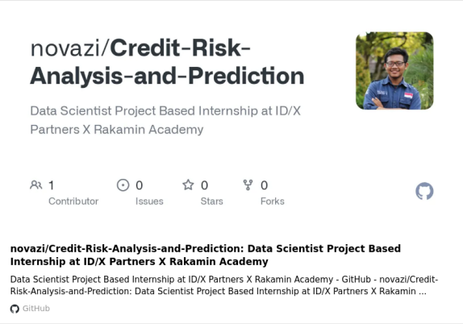

My Project File
https://github.com/novazi/Credit-Risk-Analysis-and-Prediction
12

Slide 18
Terima Kasih

